Slide 1



BRITISH AIRWAYS CUSTOMER BOOKING PREDICTION
MACHINE LEARNING PROJECT USING RANDOM FOREST CLASSIFIER
NAME
Pawan Kushwah
DATE
28 May,2026

Slide 2

OBJECTIVE
DATASET
Build a machine learning model to predict whether a customer will complete a booking using customer behavior and travel data.
Dataset Overview:
• 50,000 records
• 13 input features
• Target variable: booking_complete
Features Included:
• Purchase lead
• Flight duration
• Passenger count
• Flight timing
• Meals & baggage preferences
BRITISH AIRWAYS

Slide 3



MACHINE LEARNING WORKFLOW
Data Cleaning
Feature Encoding
Train-Test Split
Random Forest Model Training
Model Evaluation
Feature Importance Analysis

Slide 4

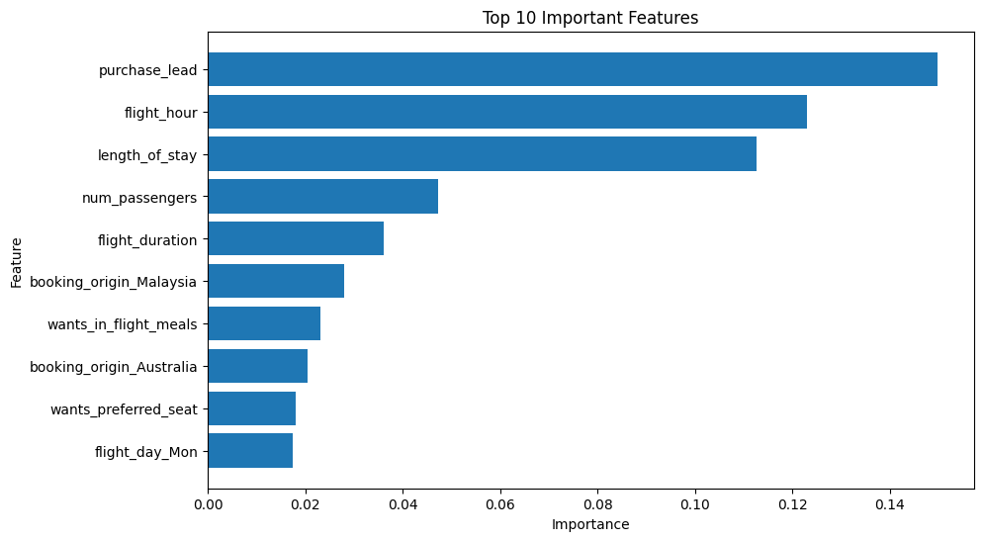
RESULTS & VISUALIZATION
MODEL PERFORMANCE :
Accuracy: 85.59%
KEY FINDINGS
• Purchase lead time was the strongest predictor.
• Flight hour and length of stay influenced bookings significantly.
• Customers selecting meals and preferred seats were more likely to complete bookings.

Slide 5

CONCLUSION
The Random Forest model successfully predicted customer booking completion with strong accuracy.
The analysis showed that booking timing, travel duration, and additional services significantly influence customer behavior.
This model can help British Airways improve customer targeting and marketing strategies.
BRITISH AIRWAYS

